Slide 1
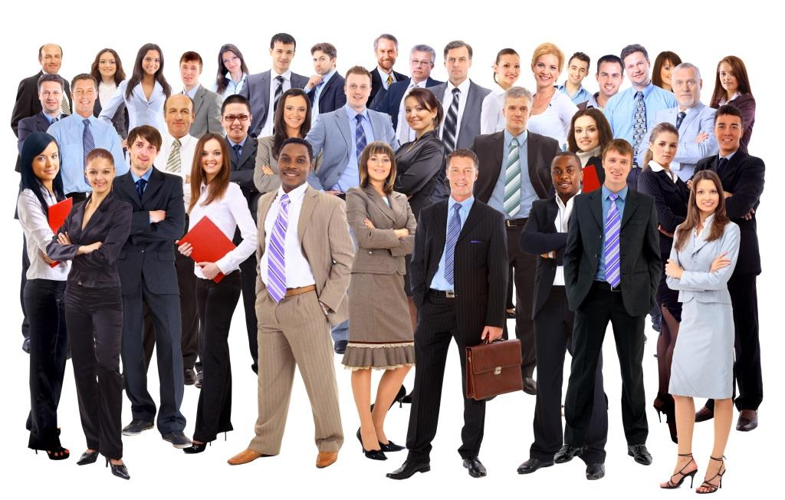
Seattle-Tacoma Job Fair
Demographics

Slide 2
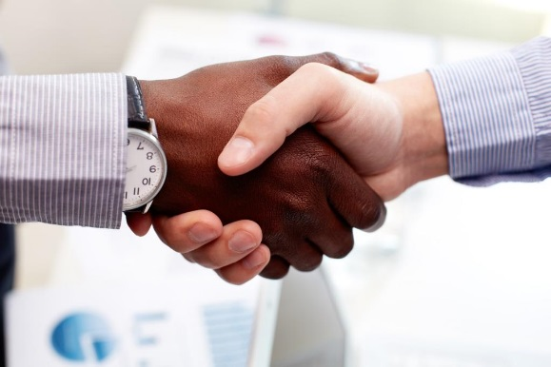
Importance to Community
Brings employers and employees together
Helps the unemployed find jobs
Helps the underemployed find better jobs
Improves the financial health of our community

Slide 3
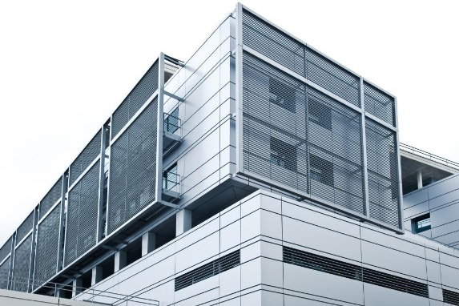
Companies Attending
A few of the 50 companies attending are:
Birch Bros. Technologies
Pacific Rim Adjustors
Dykstra & Herwig
Lakewood Marketing
Drake Consulting
HMM Advertising
Pro-Temps, Inc.

Slide 4
Age of Attendees

Slide 5
Attendees Currently Unemployed

